Slide 1

Starter: What’s the Difference?
1. Concentrated vs. Dilute?
2. Strong vs. Weak?
3. Concentrated vs. strong?
Draw diagrams if you like…

Slide 2
Conductivity of Strong and Weak Acids
Conductivity requires the presence of mobile charged particles (in this case ions).
Since strong acids fully dissociate or fully ionise then it will have far MORE ions than a weak acid of the same concentration
Strong acids create solutions with good electrical conductivity as the acid has fully dissociated and there is a high concentration of ions in solution.
Weak acids create solutions with poor electrical conductivity because there is a low concentration of ions in solution.

Slide 3
Conductivity of Strong and Weak Bases
Conductivity requires the presence of mobile charged particles (in this case ions).
Since strong bases fully dissociate or fully ionise then it will have far MORE ions than a weak base of the same concentration
Strong bases create solutions with good electrical conductivity as the acid has fully dissociated and there is a high concentration of ions in solution (these are mainly hydroxides).
Weak bases create solutions with poor conductivity because there is a low concentration of ions in solution (ammonia is a weak base).

Slide 4
pH
The pH is inversely proportional to the concentration of the hydronium ions in solution.
For the same concentration, a strong acid will have a lower pH than a weak acid because there is a higher concentration of hydronium ions present in solution for the strong acid compared to the weak acid.
BOTH acids will release the same number of ions but the difference in pH is due to the differences in dissociation between them.

Slide 5
Conductivity and pH
 | Strong acid | Weak acid | Weak base | Strong base
pH | 0-3 | 3-6 | 8-11 | 12-14
Conductivity | Good conductivity as high concentration of ions | Poor conductivity as low concentration of ions | Poor conductivity as low concentration of ions | Good conductivity as high concentration of ions

Slide 6
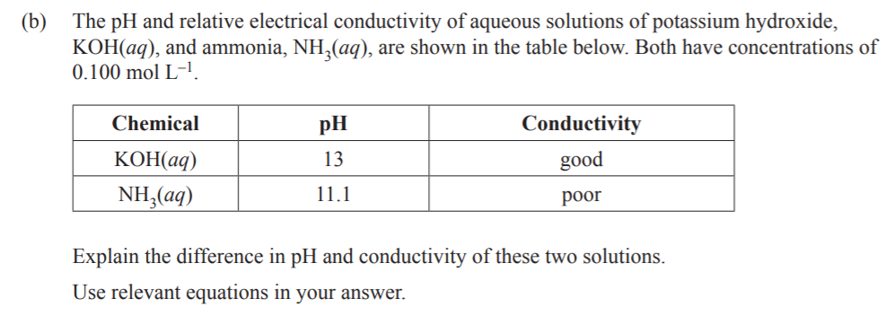

Slide 7
Acidic and Basic Salts
Many salts dissolve in water to produce solutions which are not neutral.
The first step is dissociation into ions. The salts contain an ion or ions that can react with water to form acidic or basic solutions. These solutions will be weakly acidic or basic.
Acidic salts contain the conjugate acid of a weak base (e.g. NH₄Cl)
Acidic salts form acidic solutions when one of their ions react with water and form hydronium ions.
Write equations showing that ammonium chloride is an acidic salt.

Slide 8
Acidic and Basic Salts
Basic salts contain the conjugate base of a weak acid (e.g. CH₃COONa)
Basic salts form basic solutions when one of their ions react with water and form hydroxide ions.
Write equations showing that sodium ethanoate is a basic salt.

Slide 9
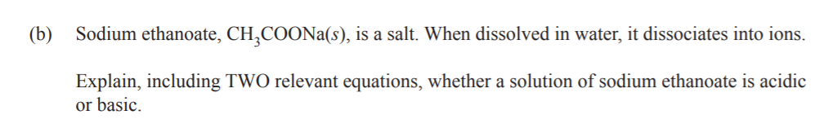
Notes:
2017

Slide 10
Conductivity of Salts
Conductivity requires the presence of mobile charged particles (in this case ions).
Salts fully split into their ions, so they will have a high conductivity, whether they are acidic, basic or neutral.
Rank the following compounds in terms of pH and conductivity of the following salts (use chemical equations to help you)
CH₃COONa, (CH₃COO)₂Mg, CH₃COOH, HCl

Slide 11
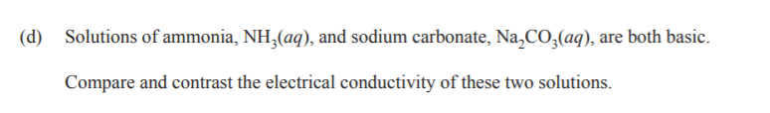
Notes:
2017

